Slide 1

天体测量学：地球参考系天球参考系 (TIRS-GCRS) 变换 (transforming coordinates from TIRS to GCRS)
2026-4-21
中山大学 珠海校区/教学大楼/珠海F206

Slide 2








How can we transform station coordinates from the terrestrial to the celestial frame? [or the other way round …]
基于Michael Schindelegger的PPT

Slide 3

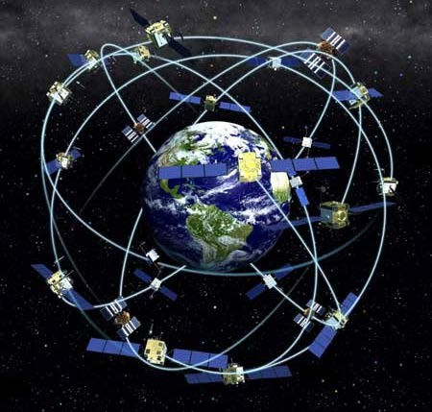


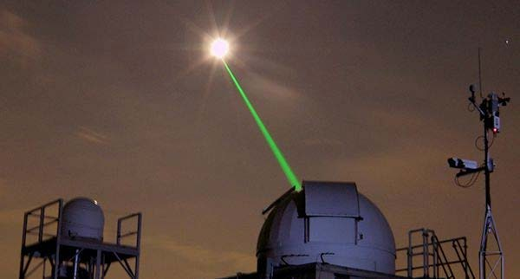
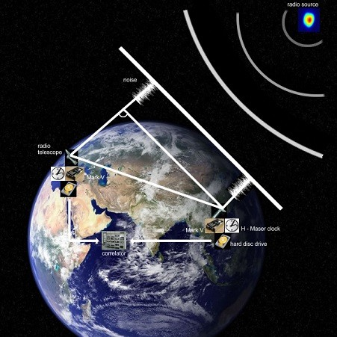
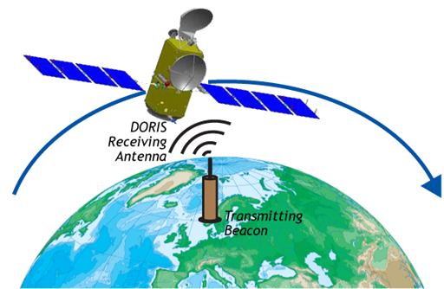
Some motivation
Observations to/from objects in space:
Analyzing observations for certain target parameters requires transformation celestial ⟷ terrestrial frame
⟹ Consideration of Earth’s variable rotation
https://www.aulis.
com/laser.htm
http://gpsx10.com/
https://www.gfz-potsdam.de

Slide 4
Outline
Contents of the lecture:
Earth rotation – an overview
Conventional reference systems
Transformation between celestial and terrestrial reference systems
Main reference: 1.李广宇
2. IERS Conventions (2010). Gérard Petit and Brian Luzum (eds.). (IERS Technical Note; 36) Frankfurt am Main: Verlag des Bundesamts für Kartographie und Geodäsie, 2010. 179 pp., ISBN 3-89888-989-6.
https://www.iers.org/IERS/EN/Publications/TechnicalNotes/tn36.html

Slide 5


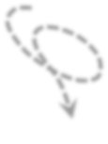



Overview
Three aspects of a variable rotation:
Earth‘s angular velocity is not constant
Orientation of the reference (e.g., rotation) axis varies with respect to space
Earth as a body changes its position with respect to this reference axis
5

Slide 6

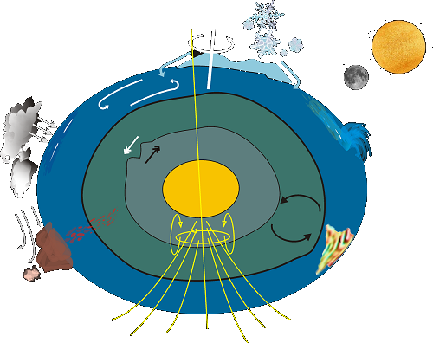
Why does the Earth not rotate …
… uniformly around an invariant axis?
The Earth‘s figure is not a sphere but rather corresponds to an oblate spheroid
Axes of rotation and maximum inertia (= figure axis) do not coincide
The Earth is neither rigid nor homogenous (deformations of solid parts, atmosphere, ocean, etc. …)

Slide 7
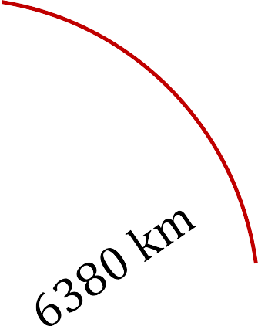

Implications for …
Measurement of time
Positioning and navigation
− On Earth (1 𝑚𝑠 ≙ 45 𝑐𝑚 at the equator / 1 𝑚𝑎𝑠 ≙ 3 𝑐𝑚)
  In space: spacecraft tracking
Geodesy: reference frame, gravity field
Earth system research
𝑏 = 𝛼 𝑟𝑎𝑑 r
= 3 𝑐𝑚
Earth
Interaction and feedback effects:
  Ocean, atmosphere, cryosphere
  Mantle, Earth’s core
𝛼 = 1 𝑚𝑎𝑠
surface
𝑏
𝛼

Slide 8
We seek quantities to describe …
The changing orientation of the rotation axis with respect to a celestial reference frame
→ precession/nutation
The changing position of the rotation axis relative to the body-fixed reference frame
→ polar motion
Variations in the rotation rate (= angular velocity) with respect to an atomic frequency standard
→ dUT1 (or ΔLOD)
⟹ 5 Earth Orientation Parameters

Slide 9
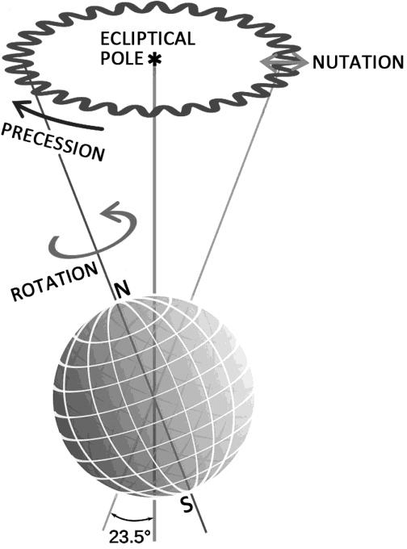
Earth Orientation Parameters
Precession und nutation:
Response of the oblate Earth to luni-solar torques
Formal separation ⟶
Precession (long-period):
  Circular movement of rotation axis around ecliptic pole
  1 revolution in 25800 yr
Nutation (short-period):
  Smaller oscillations
Credit: Luciano Pederzoli

Slide 10

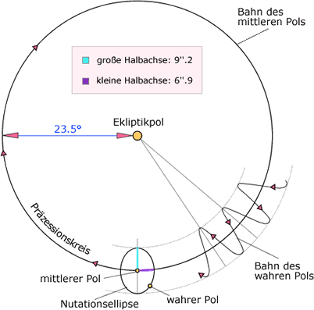




Precession/nutation
Precession period also called Great” or “Platonic Year”
Trajectory of mean pole
9.2“ ≙ 276 m
6.9“ ≙ 83 m
Nutation period with largest amplitude:
18.6 yr (Regression of the lunar node)
Ecliptic North Pole
50“/yr ≙
600 m/yr
Precessional circle
Trajectory of true pole
Nutation ellipse
10

Slide 11

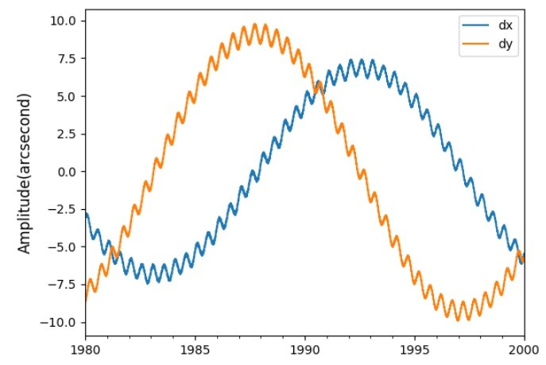
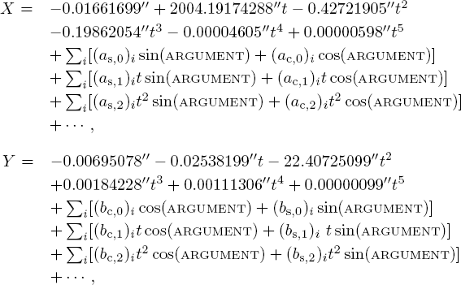
Precession/nutation
P/N can be predicted almost perfectly ⟹
Typical series expansion:
18.6 𝑦𝑟
{X, 𝑌} are two of the EOP and called nutation angles

Slide 12











Earth Orientation Parameters
Precession/Nutation ⟶ polar motion:
What is our reference axis?
Actual pole of rotation exhibits large short-term variability in the celestial frame ⟶ not suited
𝑿
Celestial Frame
𝑌 (nutation)
Reference
Pole (CIP)
Terrestrial
Frame
CIP – Celestial Intermediate Pole

Slide 13
Earth Orientation Parameters
Precession/Nutation ⟶ polar motion:
Reality: we use a conventional reference pole = CIP
Intermediate pole in the eventual transformation
Polar motion angles {𝑥_{𝑝}, 𝑦_{𝑝}} also refer to CIP
Celestial
𝑦_{𝑝}
Reference Pole (CIP)
Frame
Terrestrial
Frame
𝑥_{𝑝} (polar motion)

Slide 14
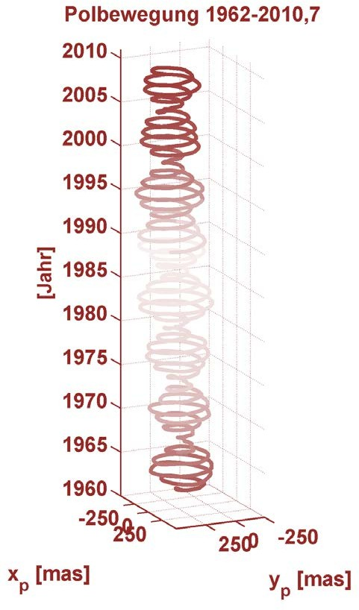
Polar motion – Geophysical effects
„1st order“ pole trajectory:
Chandler Wobble
  Free oscillation of the Earth
  Period ∼ 433 days
Annual Wobble
  Forced oscillation, main driver (∼75%) are annual pressure over continental areas
⇒
Beat with a period of 6.3 yr and peak amplitudes of 9 m
14

Slide 15
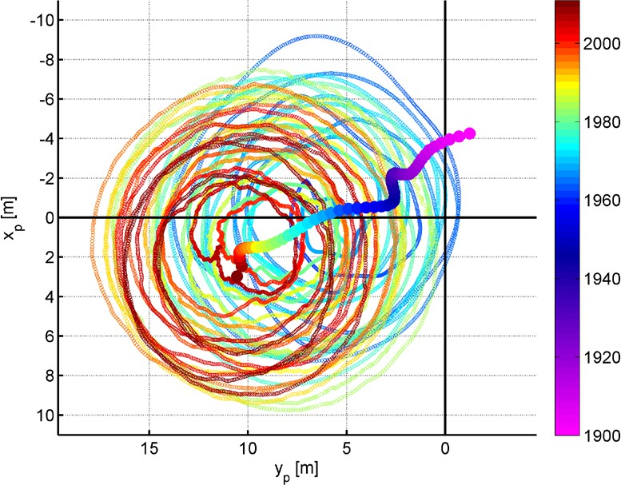
Polar motion – Geophysical effects
Secular polar motion:
Pole trajectory 1962.0 – 2010.7
(Linear) drift of the reference pole:
– 10 𝑐𝑚/𝑦𝑟 towards
78° W
  Main cause: glacial isostatic adjustment
Sudden changes since 2005 may have other causes (ice sheet melt, terrestrial water …)

Slide 16
Earth Orientation Parameters
5th EOP ⟶ Variations in the rate of rotation
Understanding of time scales
required, particularly UT1 (Universal Time – corrected for polar motion effects)
Phase angle of a terrestrial object w.r.t. a reference point on a sphere
0°/Gr.

For more information, see: https://www.timeanddate.com/ti me/universal-time.html
Instantaneous phase angle
≙ UT1

Slide 17

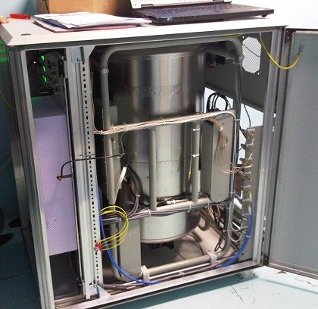

Universal Time – ΔLOD
Universal Time UT1, changes in length-of-day
Variations of the rotation rate can be expressed as deviations of UT1 from an atomic time scale (such as UTC) …
UT1-UTC = dUT1
… or as perturbations of the nominal rotation rate 1⁄86400 𝑠𝑒𝑐
ΔLOD (Excess of length-of-day)
Atomic frequency
standard
d
∆LOD = −
dUT1
dt
17

Slide 18


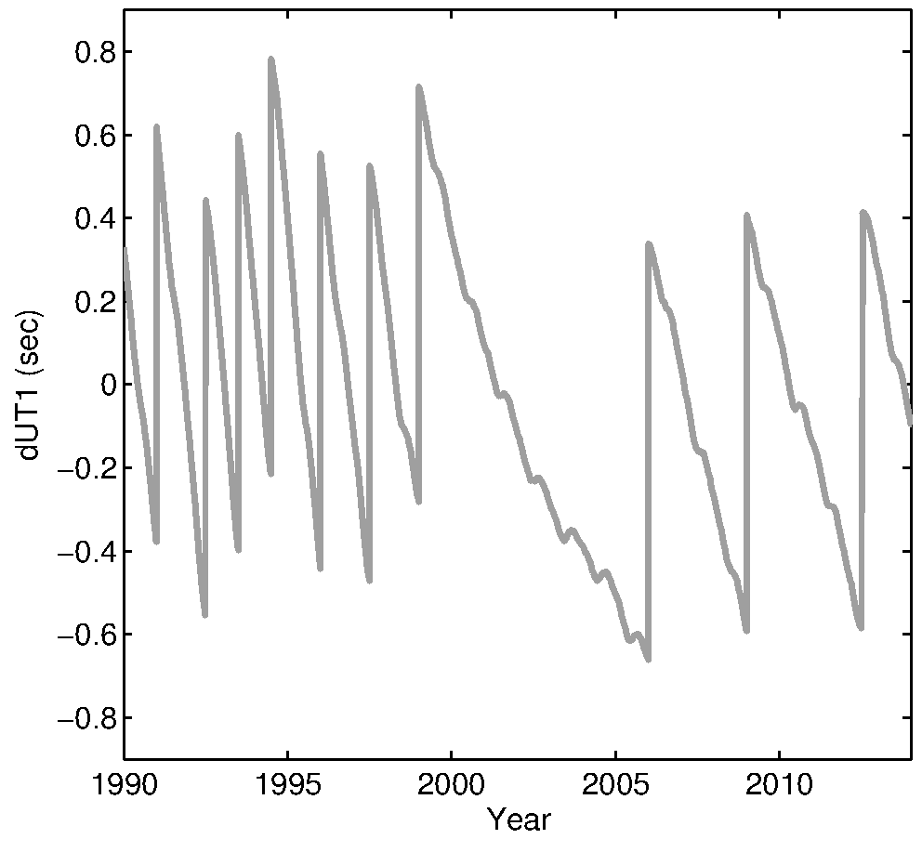
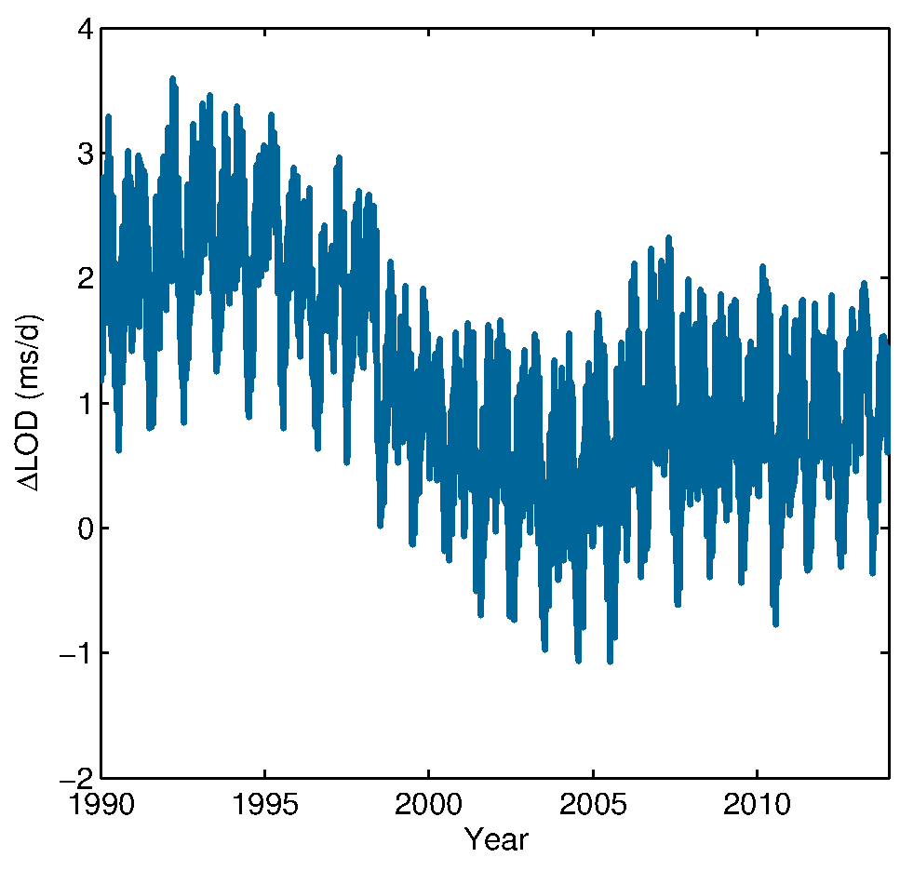
Universal Time – ΔLOD
UT1-UTC < 0.9 s
ΔLOD (ms)
leap seconds
UT1-UTC without jumps
differentiation

Slide 19
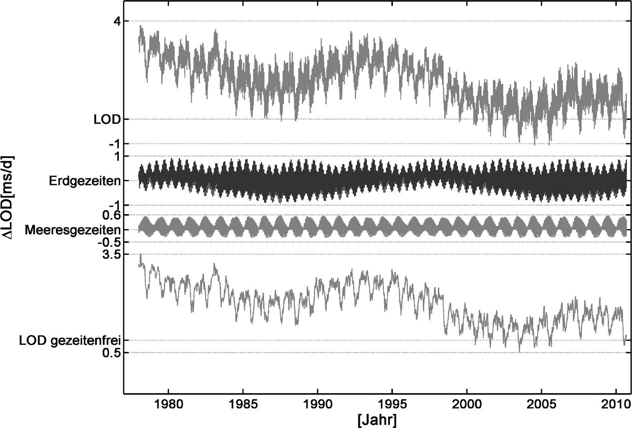
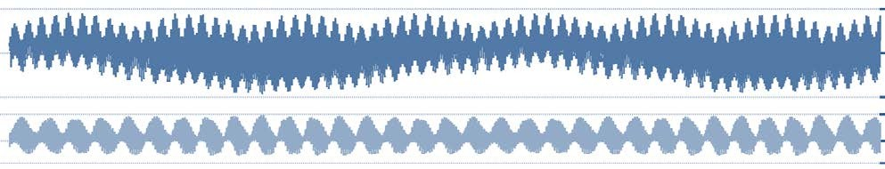
ΔLOD – Geophysical effects
Solid Earth tides
Ocean tides
Residuals are irregular or quasi-periodic …

Slide 20

Outline
Contents of the lecture:
Earth rotation – an overview
Conventional reference systems
Transformation between celestial and terrestrial reference systems
Reference System ⟷ Reference Frame
Earth Orientation Parameters
X, 𝑌, 𝑥_{𝑝}, 𝑦_{𝑝}, dUT1

Slide 21


Reference systems
International Terrestrial Reference System
ITRS is geocentric and co-rotates with the Earth
Unit length is the meter (SI)
Orientation of axes 𝑥, 𝑦, 𝑧
follows conventions:
Requirement that 𝑥, 𝑦, 𝑧 are aligned with a previous realization: BIH at epoch 1984.0
Arbitrary definition
Bureau International de l‘Heure (BIH) at Paris Observatory

Slide 22
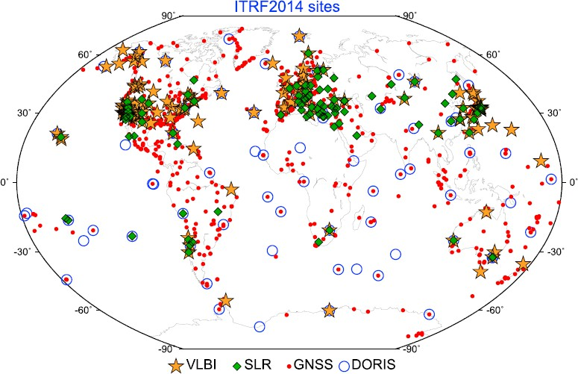
Reference systems
International Terrestrial Reference Frame
ITRF = realization of ITRS by virtue of positions and velocities of space-geodetic stations:
  ITRF94 ITRF96 … ITRF2008 ITRF2014
1499 observing stations at 975 sites

Slide 23
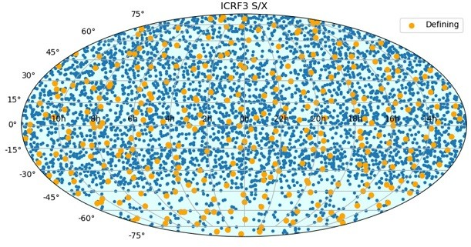
Reference systems
Internat. Celestial Reference System/Frame
Both definition (ICRS) & realization (ICRF) constrained by stable “defining” radio sources:
ICRF2 (2009): 295 defining
ICRF3 (2018): 303 defining
Celestial coordinates of these sources observed with VLBI (Very Long Baseline Interferometry)

Slide 24

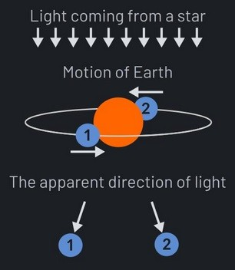
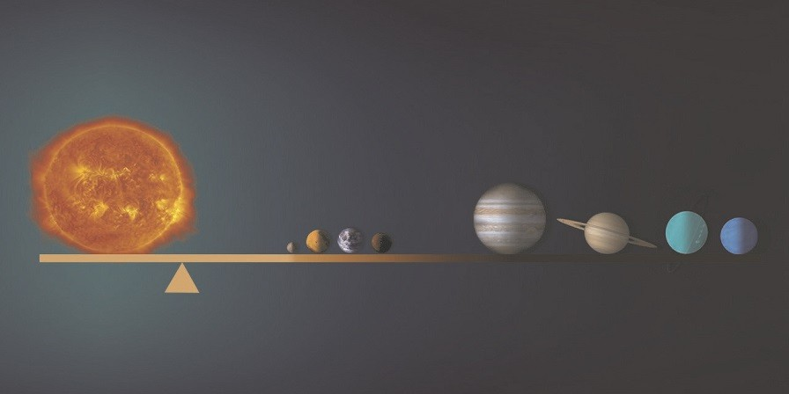
Reference systems
Internat. Celestial Reference System/Frame
ICRS is barycentric, but in the following …
We assume that it is geocentric and the necessary corrections have been applied, e.g., aberration
Barycenter Geocenter
https://flatearth.ws/stellar-aberration
https://phys.org/

Slide 25
Outline
Contents of the lecture:
Earth rotation – an overview
Conventional reference systems
Transformation between celestial and terrestrial reference systems
Previously: transformation based on ecliptic, vernal equinox , nutation in obliquity, …
Here: IAU 2000/2006 resolutions

Slide 26














Transformation TRS ⟷ CRS
“Top view” of the IAU 2000 transformation
Involves intermediate system(s) that are tied to the CIP (see slide 12):
𝘙(𝑡)
Pole of the CRS
𝑸(𝑡)
Pole of the TRS
W(𝑡)
CIP
𝐶𝑅𝑆
= 𝑄 𝑡
𝑅 𝑡
T𝑅𝑆
W(𝑡)

Slide 27
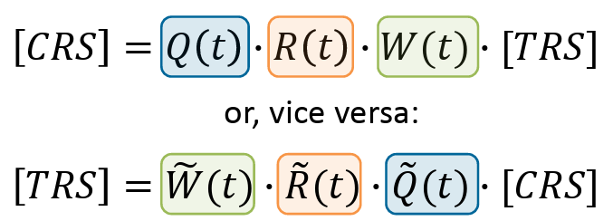
Transformation TRS ⟷ CRS
In all clarity (before addressing some details):
𝑄 𝑡 …
𝑅 𝑡 …
Nutation Earth’s spin Polar motion
Rotation matrices account for …
(at a particular epoch)
W(𝑡) …

Slide 28
Transformation TRS ⟷ CRS
Non-rotating origins (NRO):
Kinematical definition, two NROs:
  Celestial Intermediate Origin (CIO) ⟶ takes over the role of the vernal equinox in the transformation
  Terrestrial Intermediate Origin (TIO)
NROs always on the equator of the CIP
Their positions depend on the history of CIP motion
CIP & respective NRO define 2 intermediate systems
  Celestial Intermediate Reference System (CIRS)
  Terrestrial Intermediate Reference System (TIRS)

Slide 29
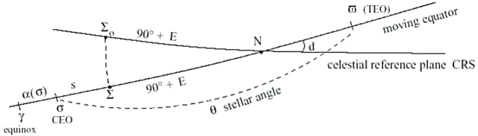
Transformation TRS ⟷ CRS
NRO in the CRS → CIO or σ, positioned on the CIP equator using the angle s
Celestial Interm. Reference System
TIRS
ϖ = TIO
CIRS
s
σ
= NRO (CIO)
Σ₀: x-origin of ICRS
Σ: auxiliary point on ICRS meridian
σ₀: the position of the CIO at J2000.0

Slide 30
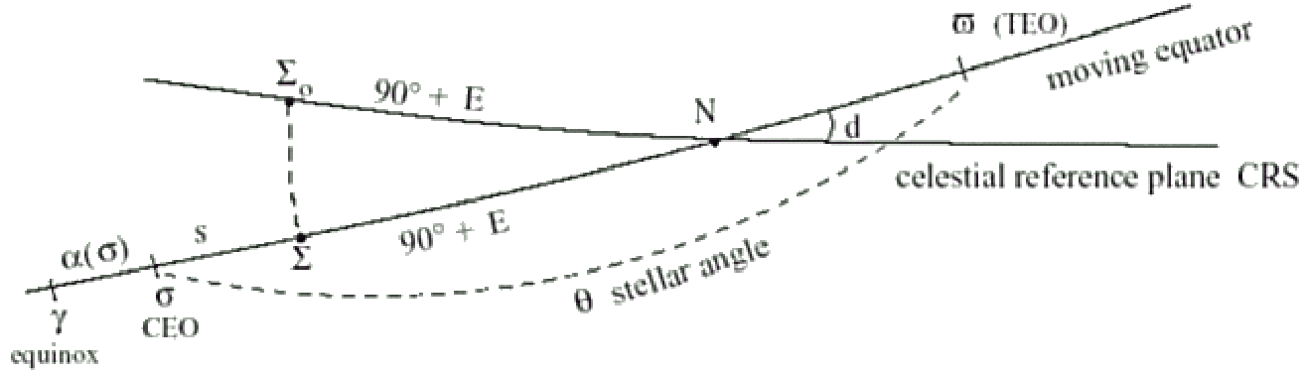
Transformation TRS ⟷ CRS
Precession/Nutation matrix:
𝑄 (𝑡) = 𝑅_{𝑧}(−𝐸)𝑅_{𝑦}(−𝑑)𝑅_{𝑧}(𝐸 + 𝑠)
CIP 向量e₃’ 的经角 E
和余纬角 d
CIO 变换矩阵
Coordinates of the CIP in CRS:
CIO Locator s:
X = sin 𝑑
𝑌 = sin 𝑑
𝑍 = cos(𝑑)
cos(𝐸) sin(𝐸)
s t = −∫
t₀
X (t )Y˙(t )− X˙ (t )Y (t )
1+ Z (t )
( )
t
dt + const
ϖ
σ
30
该变换为天球中间参考系-天球参考系 (CIRS-GCRS) 变换.

Slide 31
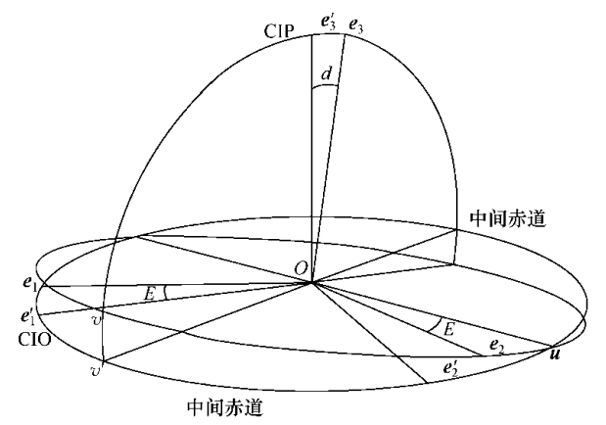

中间极和中间赤道在 GCRS 中的运动
GCRS
(e₁, e₂, e₃)为 GCRS坐标轴单位向量
(e₁’, e₂’, e₃’)为 CIRS坐标轴单位向量.
u , v 和 v’ 分别为交线和投影线单位向量
CIP 向量e₃’ 的方向由经角 E 和余纬角 d 确定，且满足方程
(4.1)
31

Slide 32

中间极和中间赤道在 GCRS 中的运动
GCRS
CIRS
总角速度向量:
ω = Ė e₃ + ḋ u (4.2)
代入上式 (4.1)
(4.3)
CIP 向量e₃’ 连带中间赤道绕原点O的转动有两个分量:
1. 绕轴e₃ ，角速度向量为 Ė e₃ 的转动;
2. 绕轴 u ， 角速度向量为 ḋ u 的转动
32

Slide 33
中间极和中间赤道在 GCRS 中的运动
GCRS
CIRS
ω₁
ω₂
(4.3)
ω₁绕e₃’ 轴(CIP)沿中间赤道经度方向的转动
ω₂ 是沿中间赤道纬度方向的转动
33

Slide 34
中间赤道上的无转动点 （CIO）
GCRS
CIRS
取e₁’指向 CIO， 指定该基本方向构建CIRS
ICRS 指定GCRS 的基本方向 e₁ 尽可能接近历元平春分点
ω₁
ω₂
(4.3)
在中间赤道上取一点，假定它在天球系中转动的角速度向量为ω₂ ，则它随着中间赤道在纬度方向一起转动，所以不会离开中间赤道
CIO
又不随着中间赤道绕 e₃’ 轴在经向转动.
34

Slide 35
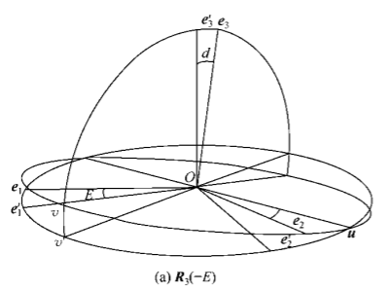
Transformation TRS ⟷ CRS
Precession/Nutation matrix:
𝑄 (𝑡) = 𝑅_{𝑧}(−𝐸)
CIO 变换矩阵
(e₁ , e₂) 在天球赤道面内绕第三轴 e₃ 逆时针旋转角 E
35

Slide 36
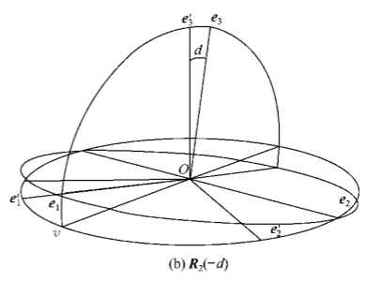
Transformation TRS ⟷ CRS
Precession/Nutation matrix:
𝑄 (𝑡) = 𝑅_{𝑧}(−𝐸)𝑅_{𝑦}(−𝑑)
CIO 变换矩阵
(e₃ , e₁) 在垂直于交线的平面内绕第二轴 e₂ 逆时针旋转角 d
36

Slide 37
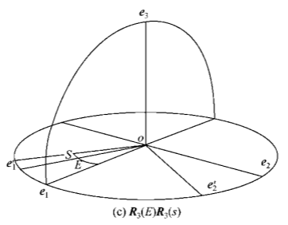
Transformation TRS ⟷ CRS
Precession/Nutation matrix:
𝑄 (𝑡) = 𝑅_{𝑧}(−𝐸)𝑅_{𝑦}(−𝑑)𝑅_{𝑧}(𝐸 + 𝑠)
CIO 变换矩阵
(e₁ , e₂)在中间赤道面内绕中间极向量 e₃ 顺时针旋转角 E + s
37

Slide 38
Transformation TRS ⟷ CRS
Earth rotation matrix:
𝑅(𝑡) = 𝑅_{𝑧}(−𝐸𝑅𝐴)
𝐸𝑅𝐴 … Earth Rotation Angle
𝐸𝑅𝐴 proportional to dUT1, only input
UT1-UTC
𝐸𝑅𝐴 𝑇_{𝑢} = 2𝜋 0.7790572732640 + 1.00273781191135448 𝑇_{𝑢}
𝑇_{𝑢} = mjd UT1 epoch − 51544.5
mjd 1.9.2020 = 59093
mjd UT1 epoch = 59093 + ^{16/}24 ^{+ 𝑑𝑈𝑇1/}24x3600
Modified Julian Date of the observation epoch, e.g., 1.9.2020, 16:00 UTC:

Slide 39
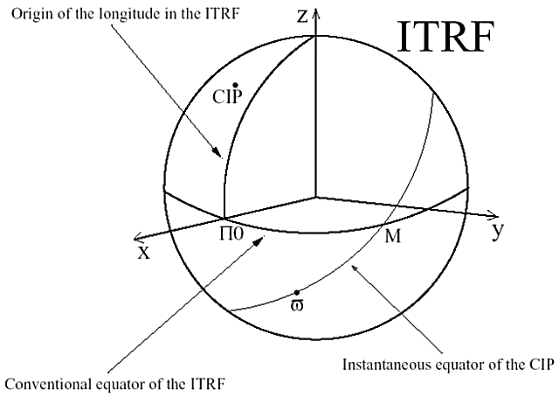
Transformation TRS ⟷ CRS
NRO in the TRS → TIO or ϖ, positioned on the CIP equator using the angle s'
Terrestrial Interm. Reference System
TIRS
Π₀: x-origin of ITRS
Π: auxiliary point on the ITRS meridian
= NRO (TIO)
Π
s'

Slide 40
Transformation TRS ⟷ CRS
Polar motion matrix:
W(𝑡) = 𝑅_{𝑧}(−𝑠')𝑅_{𝑦}(𝑥_{𝑝})𝑅_{𝑥}(𝑦_{𝑝})
TIO Locator s' reflecting CIP history (usually negligible):
t
x_{p} y˙ _{p} − x˙_{p} y_{p}
s = ∫
′
dt
= NRO (TIO)
2
Π
t₀
s'

Slide 41
Transformation TRS ⟷ CRS
Summary:
Five Earth Orientation Parameters
Their physical meaning and practical relevance
Importance of (global) reference systems
Astrometry sub-routines:
  https://www.iausofa.org/current-software (SOFA)
  NOVAS (Naval Observatory Vector Astrometry Subroutines), in C/Fortran/Python

